Slide 1
USING PREDICATE LOGIC

Slide 2
Representation of Simple Facts in Logic
What is Propositional Logic (PL)?
Propositional logic is a study of propositions.
Each proposition has either a true or a false value but not both at a time.
Propositions is represented by variables.
For example: Symbols 'p' and 'q' can be used to represent propositions.

Slide 3
Types of proposition
There are two types of propositions:
1. Simple proposition
2. compound proposition
1. A simple proposition : It does not contain any other preposition.
For example: Rocky is a dog.
2. A compound proposition : It contains more than one prepositions.
For example: Surendra is a boy and he likes chocolate.

Slide 4
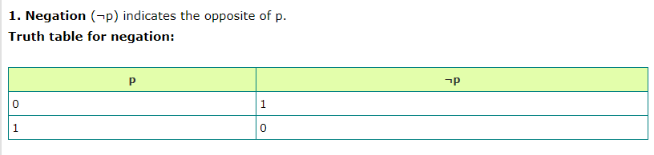
Connectives of compound preposition

Slide 5
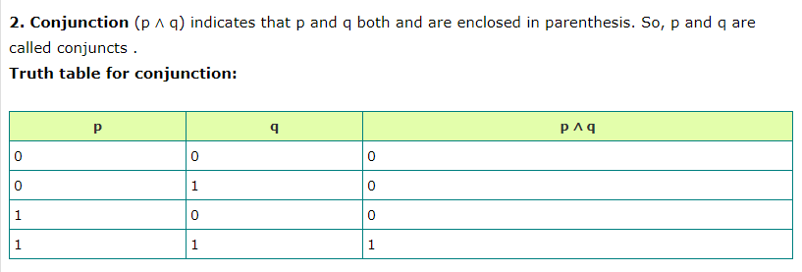

Slide 6
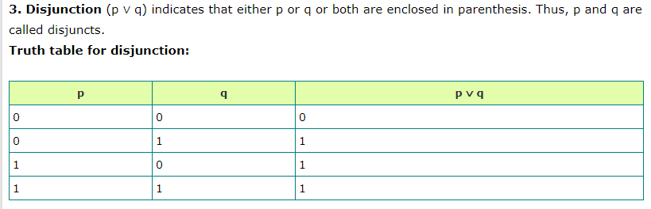

Slide 7
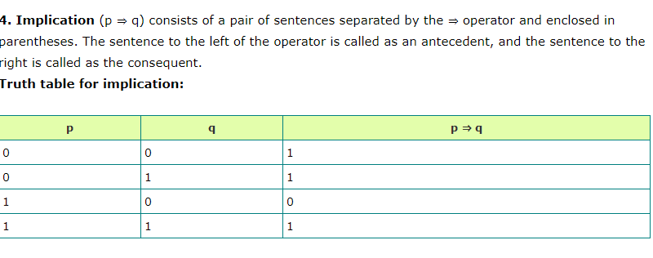

Slide 8
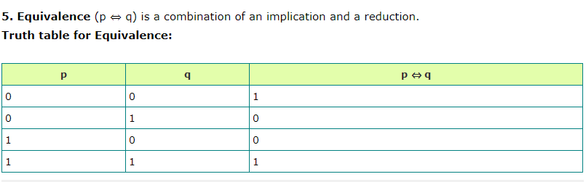

Slide 9
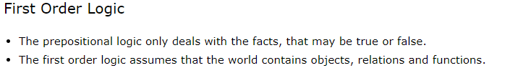

Slide 10
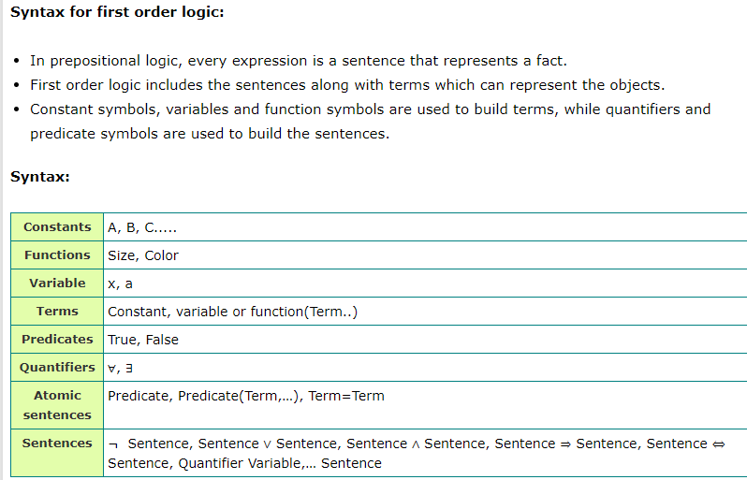


Slide 11
Example
Consider the sentence “Elephants are big”.
There are many ways to represent this sentence.
HasSize(Elephant, Big)
SizeOF(Elephant)= Big
Alternate syntax,
IsEqual(SizeOf(Elephant, Big),
This states that a object Elephant is big, which is a useless fact in any reasoning process about the Elephants in general. So lets represent that all Elephants are big.
So, we can find FOL statement as, All things that are Elephants are big.
  For all things x, for which x is a Elephant, x is big.
  For all things x, if x is a Elephant, then x is big.
Finally the FOL will be written as.
∀x Elephant (x) ⇒ Big(x)

Slide 12
Steps to develop the knowledge base:
1. Identify the problem or task.
2. Assemble the relevant knowledge to the given problem or task.
3. Decide on a vocabulary of predicates, functions and constants.
4. Encode the general knowledge about the domain and a description of the specific problem instance.
5. Apply queries to the inference procedure and get the answers.
6. Finally, debug the knowledge base.

